Slide 1
Home Storage
Management System
HSMS – is an intuitive and efficient application designed to help you organize and track household storage

Slide 2


HSMS – is a part of our big Smart Home project
Smart Home
Smart Security
HSMS
Android / IOS
Lighting Modules
Planning System

Slide 3
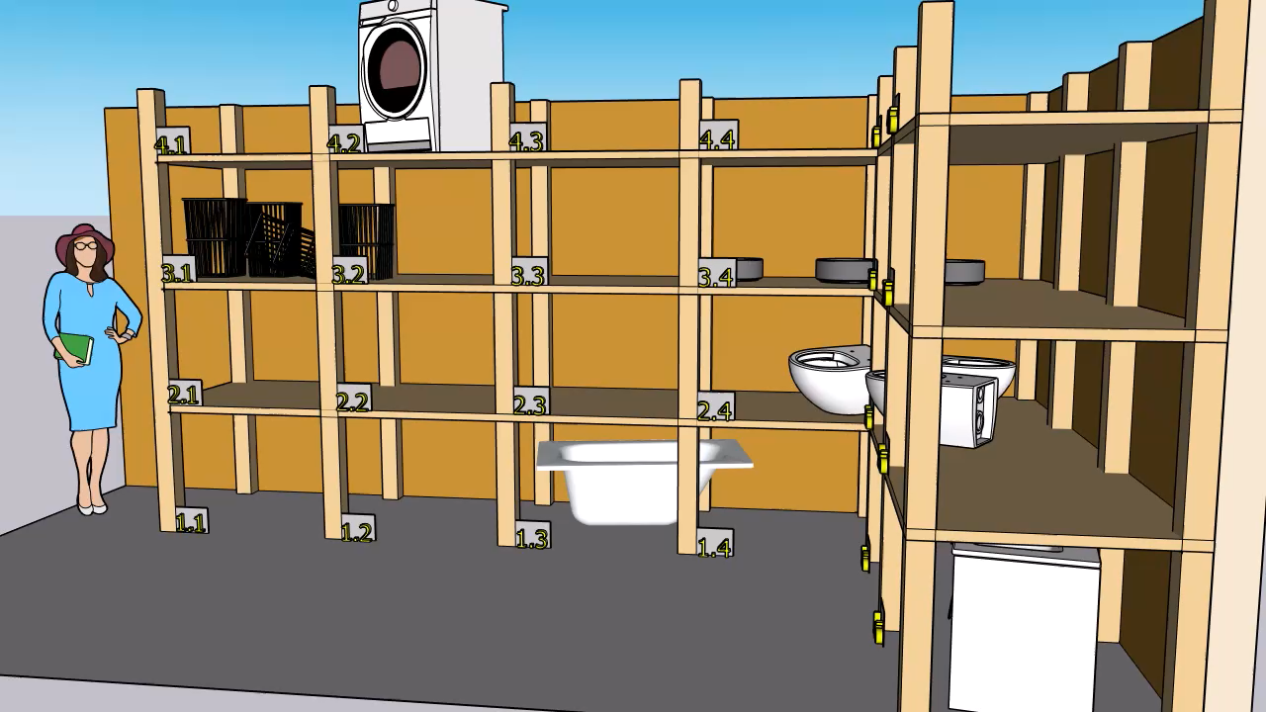
Your Home Storage

Slide 4
What problem does it solve
The Home Storage Management System is an intuitive and efficient application designed to help you organize and track household storage. Whether you need to manage pantry items, tools, or any other household goods, this app provides an easy way to store, retrieve, and monitor your belongings.

Slide 5
Key features
Manage Shelves: Create, rename, and remove shelves to keep your storage structured.
Product Management: Add new products, place them on a shelf, take them when needed, and replace them if necessary.
Fast Search: Quickly locate items with an efficient search function.
Organized Storage: Categorize items and optimize space utilization.
Expiration Date Tracking: Keep track of item expiration dates to reduce waste.
Shelf Monitoring: Track shelf filling by weight or volume to prevent overloading.

Slide 6
Authentication in App
One App for each family member
HSMS
Mother
Father
Son
Daughter
Grandpa
Grandma

Slide 7
Time Schedule planning
Dima
Sergi
Task | DeadLine
GitHub. Create repository | 02/09/25
Readme.md | 02/09/25
Create basic classes and objects | 02/09/25
Describe classes: Product, Shelf | 02/10/25
Create user console menu | 02/10/25
Create Application class and describe the main features | 02/13/25
Implementation: Core functionality, Exception Handling, Input validation | 02/13/25
Increasing complexity, improve the project | 02/16/25
Final touches: polish the code, Prepare documentation | 02/17/25
Task | DeadLine
Create Maven project | 02/11/25
Crate class Object BTO to control *.json | 02/13/25
Create Authentication class and methods | 02/13/25
Create Application class and describe the main features | 02/13/25
Implementation: Core functionality, Exception Handling, Input validation | 02/13/25
Increasing complexity, improve the project | 02/16/25
Final touches: polish the code, Prepare documentation | 02/17/25

Slide 8
Designing, App structure
Main
Application
HomeStorage
Accounting
ObjectBTO
Shelf
User
JSON
Product

